Slide 1
Huntkey PC Cases and PSU
By Mr Anthony Lau
Mobile 0433 187 316

Slide 2
Who is Huntkey?
She is one of the biggest Manufacturer for Huntkey PSU and Huntkey PC Cases
Built to ISO9001:2000 ＆ ISO14001:2004
Member of PSMA (Power Sources Manufacturers Association
Has 5800 employees over 110,000 m2 of land
Products are certified CCC, UL, TUV, CE, CSA, FCC B

Slide 3
Bird View Of Huntkey

Slide 4
Huntkey Headquarter

Slide 5
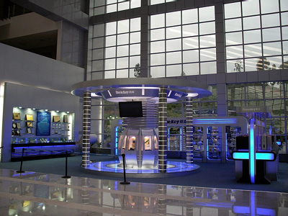
Show Room

Slide 6
Hallway lights up by SUN

Slide 7
PC Power Production Line

Slide 8
Transformer Production Line

Slide 9
Wire Production Line

Slide 10
SMT Workshop

Slide 11
R & D Lab

Slide 12
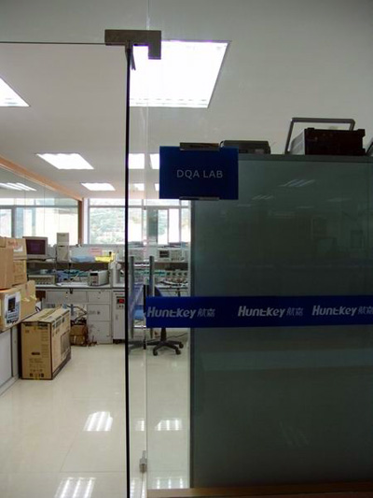
Salt Mist & DQA Labs

Slide 13
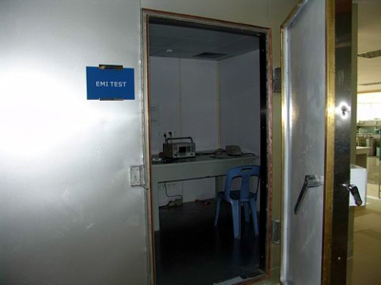
Drop Test Bending & EMI Labs

Slide 14
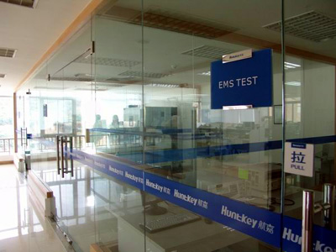
EMS & Vibration Labs

Slide 15
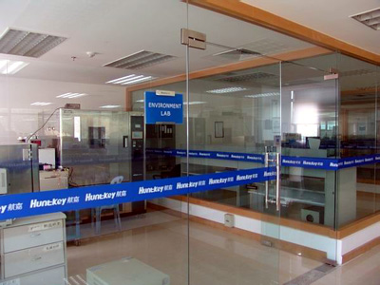
Safety & Environment Labs

Slide 16
Distributor In Australia
Powerhouse PC Pty Ltd
Unit B4 27-29 Fariola Street,
Silverwater NSW 2128
Australia
sales@powerhousepc.com.au
www.powerhousepc.com.au

Slide 17
Different type of cases
Huntkey office and home cases
Huntkey mid range cases
Huntkey gaming cases

Slide 18
Office & Home Cases
H 401

Slide 19
Hercules Cases
H001

Slide 20
Aeolus Gaming Case
H 201

Slide 21
Features of Huntkey Cases
Fashion and patented shape
Whole folded-edges design, no finger hurting
Air duct & cooling fan for air flow
ATX & BTX compatible
Front perforated for maximum heat dispersion
USB,Firewire & SATA all on top, easy access
Meet EMI standard
Robust and sturdy design

Slide 22
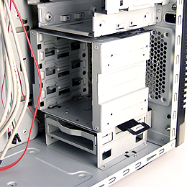
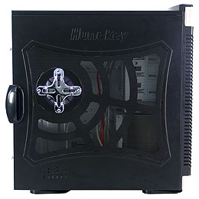
Detail view on Aeolus Case
Features: ◆ Screwless design, assembled easily ◆ ATX & BTX Compatible ◆ HDD Adjustable HDD position flexibly ◆ Front perforated net design for maximum heat dispersion
Solid 0.8 thickness egi steel plate

Slide 23
Huntkey PSU
Features:
Intel ATX12V V2.2 approved
Support multi USB function for MP4
Digital Camera, Mobile Phone
Low power consumption on
Standby (less than 1w)
Support Intel ICH8 chipset
4 pin to 8 pin connector for dual CPU
Motherboard
6 SATA connector for HDD
Safety UL, CE, CSA, TUV, FCC, CCC
EMI EN55022 Class B & FCC Part 15
Class 8
Dimension 150*86*140mm
12 CM fan
DH Power 500 Watts

Slide 24
V Power PSU
Features
Intel ATX12V V2.2
Support Vista operating system with high
end graphic card
Enhance dual +12V output capability to
18A symmetrical design for +12V1 and
+12V2
80 % High efficiency performance
Low EMI for your perfect Vista Screen
12cm for VP500 power supply unit
14cm for VP550 power supply unit
Available in V Power 500 watts and 550 Watts

Slide 25
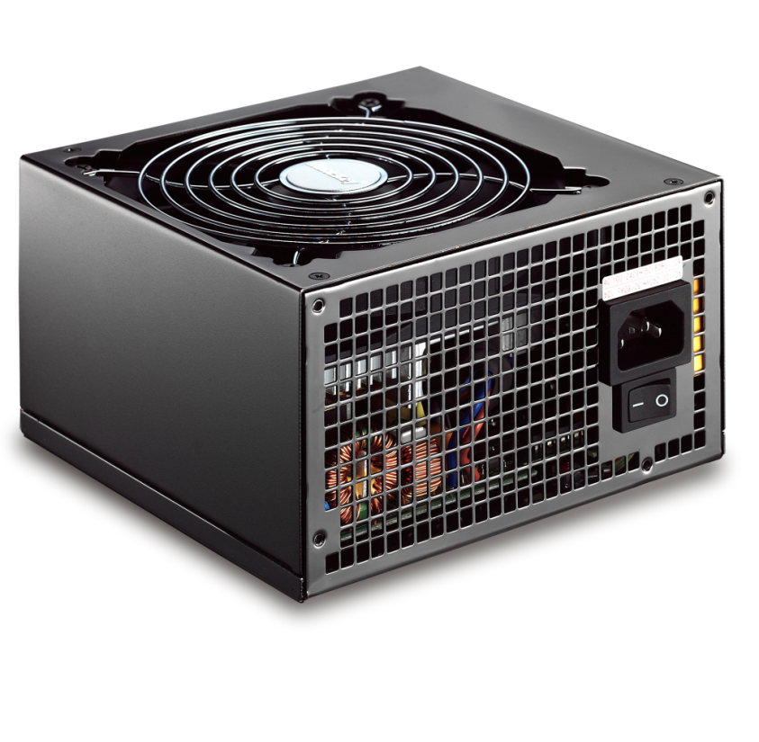
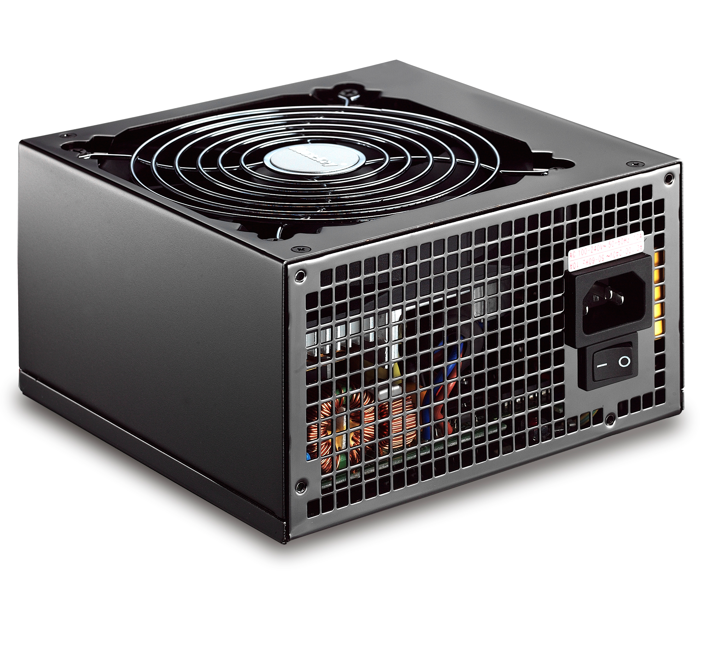
Titan PSU
Complies with ATX12V & EPS12V
Active Power Factor
correction
Four +12V output rail
Built in protection circuit OCP, OVP,UVP, OLP,SCP
SLI ready
High efficency 82%
Available in 650 Watts

Slide 26
Features of Huntkey PSU
Big 12 or 14 Cm fan
Comply with ATX12V & EPS 12V (Titan Model only)
Sli Ready and support Intel & AMD
High efficency rate 80 %
Low power consumption
Ultra low acoustic noise by big airflow and intelligent control of FAN

Slide 27
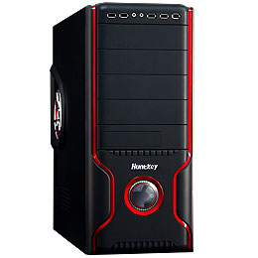
New up coming PC Cases

Slide 28
Huntkey NoteBook Adapter
65 Watts Power Adapter

Slide 29
The End
Thank you for your wonderful time
Take care and have a good thought on Huntkey products as there is a Aussie saying “Never Try Never Know”
Email to me at anthony@powerhousepc.com.au
Thank you

